Slide 1


Mineral Extraction Tracking & Production Forecasting System
Student: Mutabazi Darius
ID: 28239
AUCA — PL/SQL Practicum
Date: 05,12,2025

Slide 2
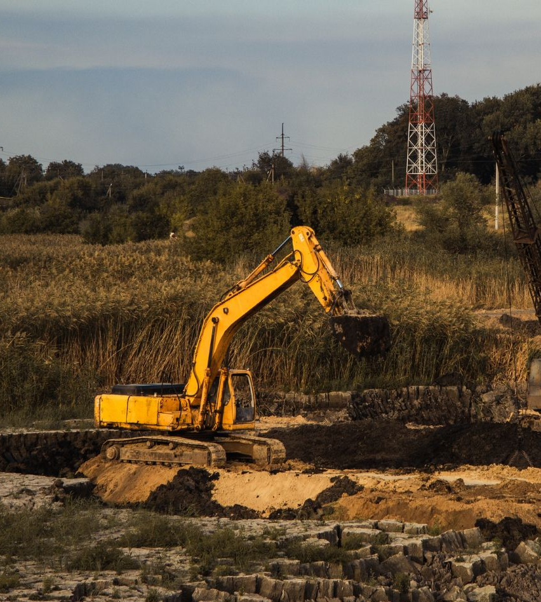
Problem(Issue , Context, Users)
Mining sites record extraction manually using logs/spreadsheets
Errors, missing data, and inaccurate daily totals
No automated forecasting for planning
Managers lack timely reports
Users affected: operators, supervisors, managers, BI analysts
Notes:
-mining companies still use manual spreadsheets.
- challenges: accuracy, lateness, no trend visibility.
- real users suffer from poor data systems.

Slide 3
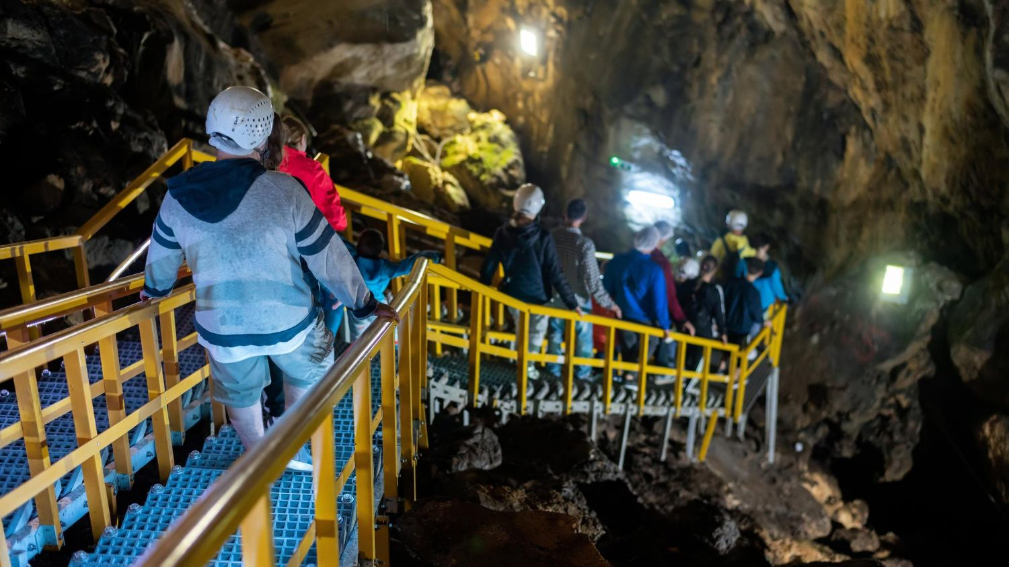
Solution (Objectives, Scope, Features)
01
Automated system to record extraction events
02
Store equipment, crew, quantity, mineral type
03
Generate daily extraction summaries
04
Produce 7-day production forecasts
05
Detect abnormal extraction patterns
Notes:
this system replaces manual logs with a PL/SQL database.
- automation reduces errors.
- forecasting helps managers plan ahead.

Slide 4
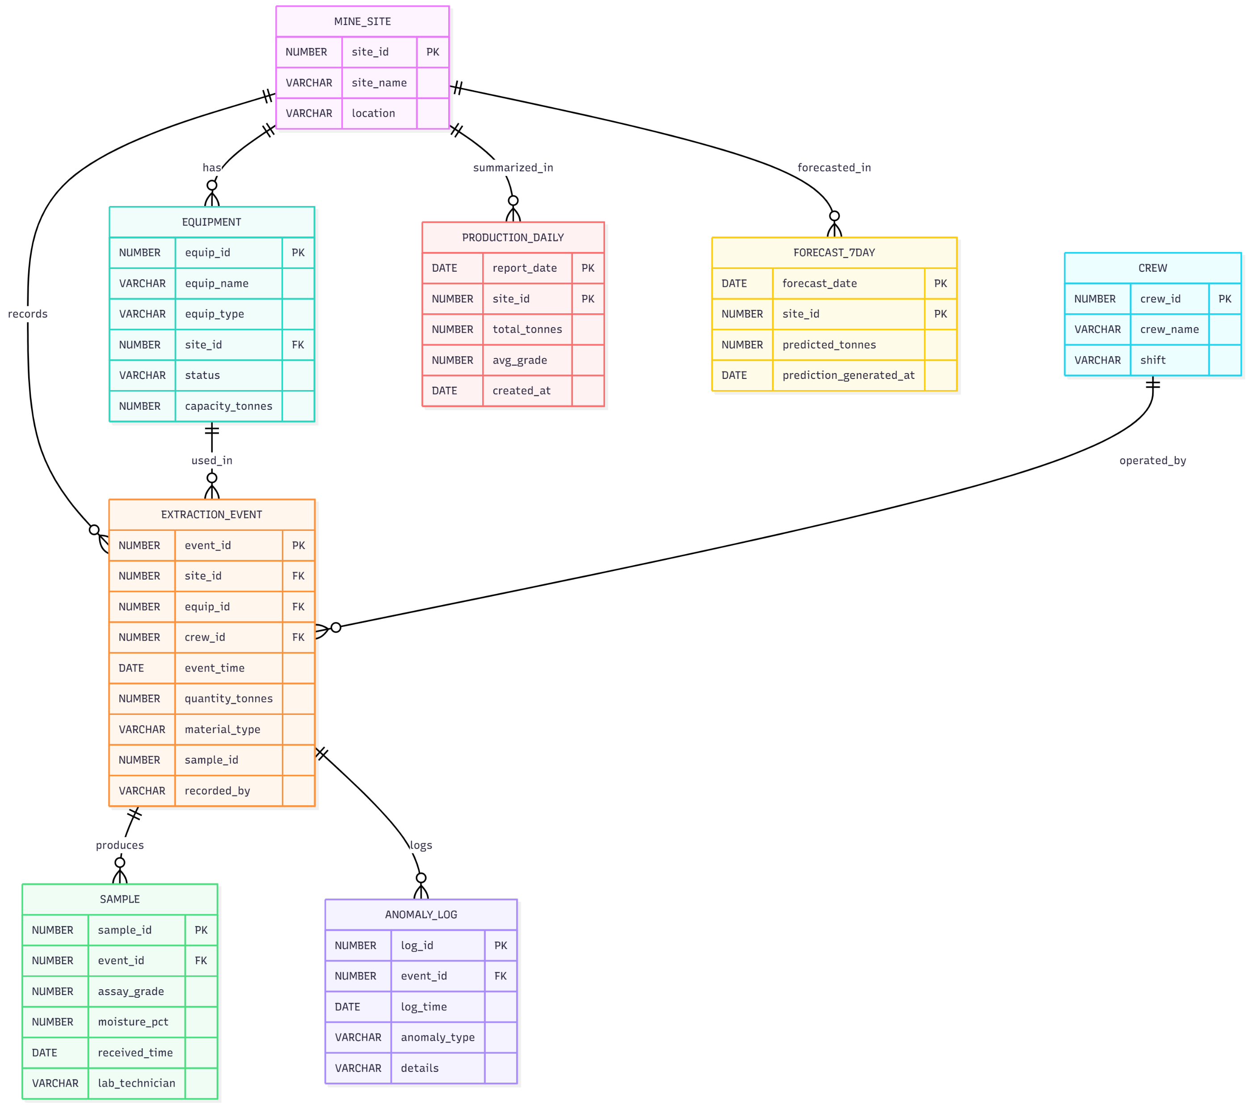
Database (ER Diagram, Entities)
Notes:
-The ER diagram shows how data is structured.
- key relationships (e.g., a site has many extraction events).
- design is normalized and efficient.

Slide 5
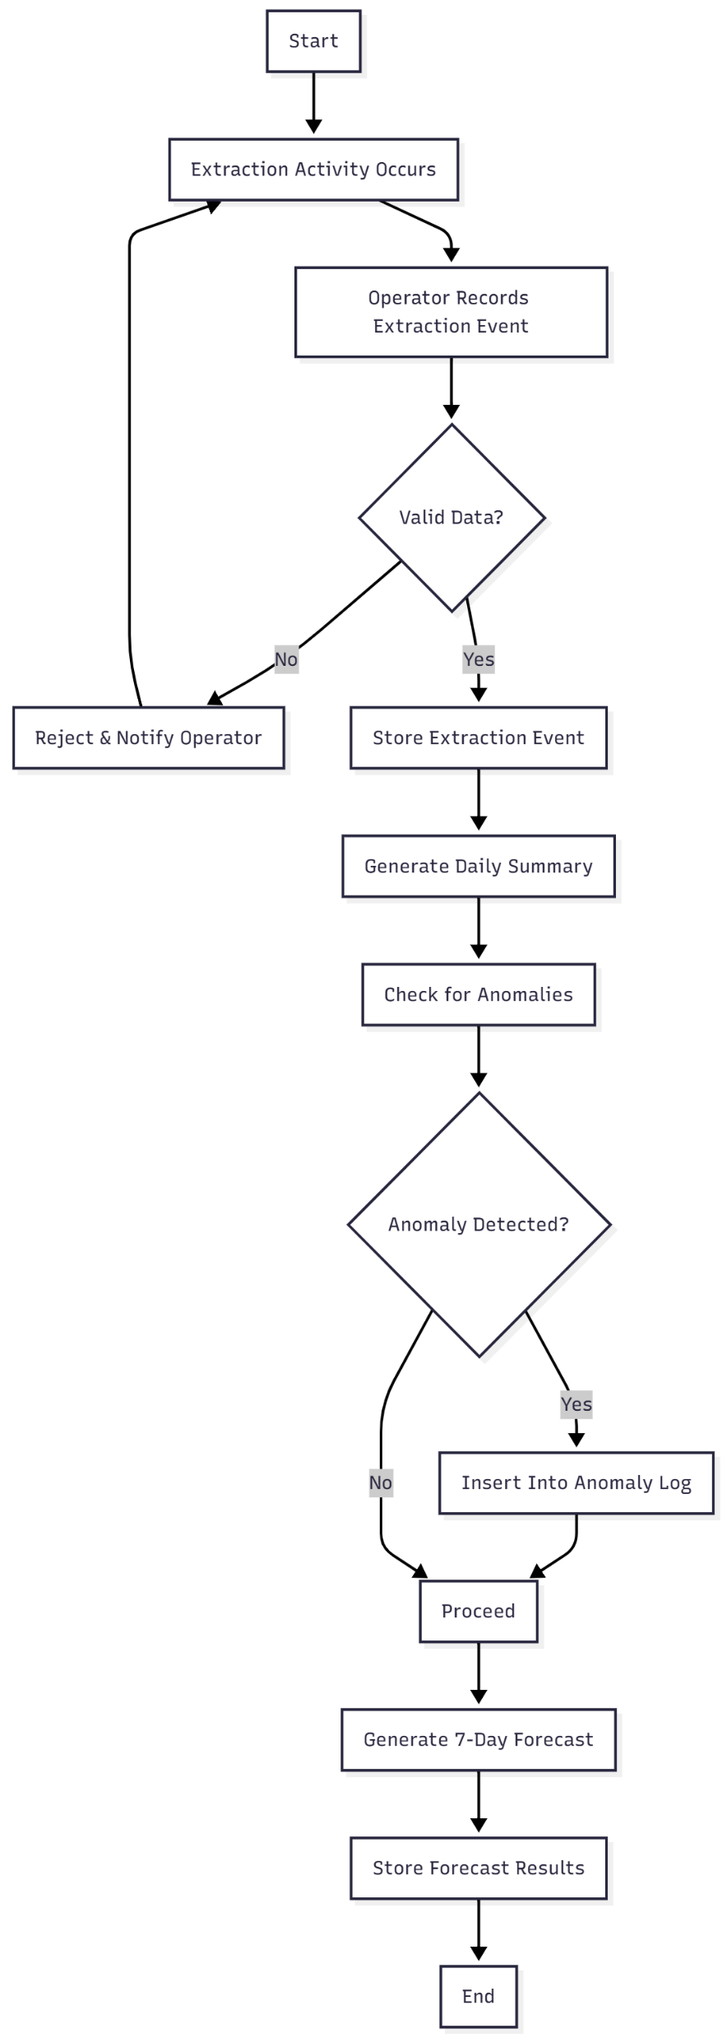
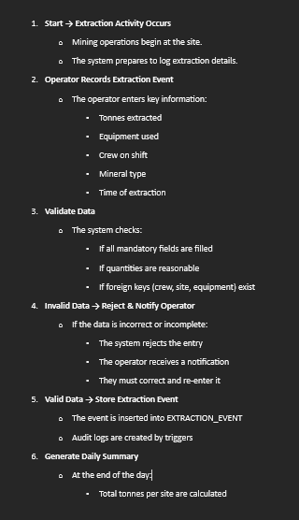
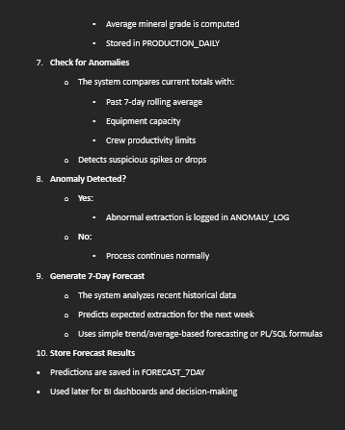
Business Process
BPMN Workflow Detailed Explanation
Notes:
-This workflow shows how data flows from the operator all the way to reporting and forecasting.
-The system ensures that only valid data is stored, which prevents wrong calculations.
-Anomaly detection helps identify suspicious extraction levels for safety and accuracy.
-The forecasting step helps the company plan production, logistics, and equipment allocation.

Slide 6

Technical (PL/SQL Technology)
v
01
I used Oracle Database 19c
04
I created triggers for auditing and validation
02
I created Table using DDL scripts
05
Creation of Sequences for primary keys
03
PL/SQL packages for:
Extraction → Summary
Forecasting
Anomaly detection
Notes:
- PL/SQL is used for automation and logic.
- use of packages to group related procedures.
- triggers enforce rules automatically.

Slide 7
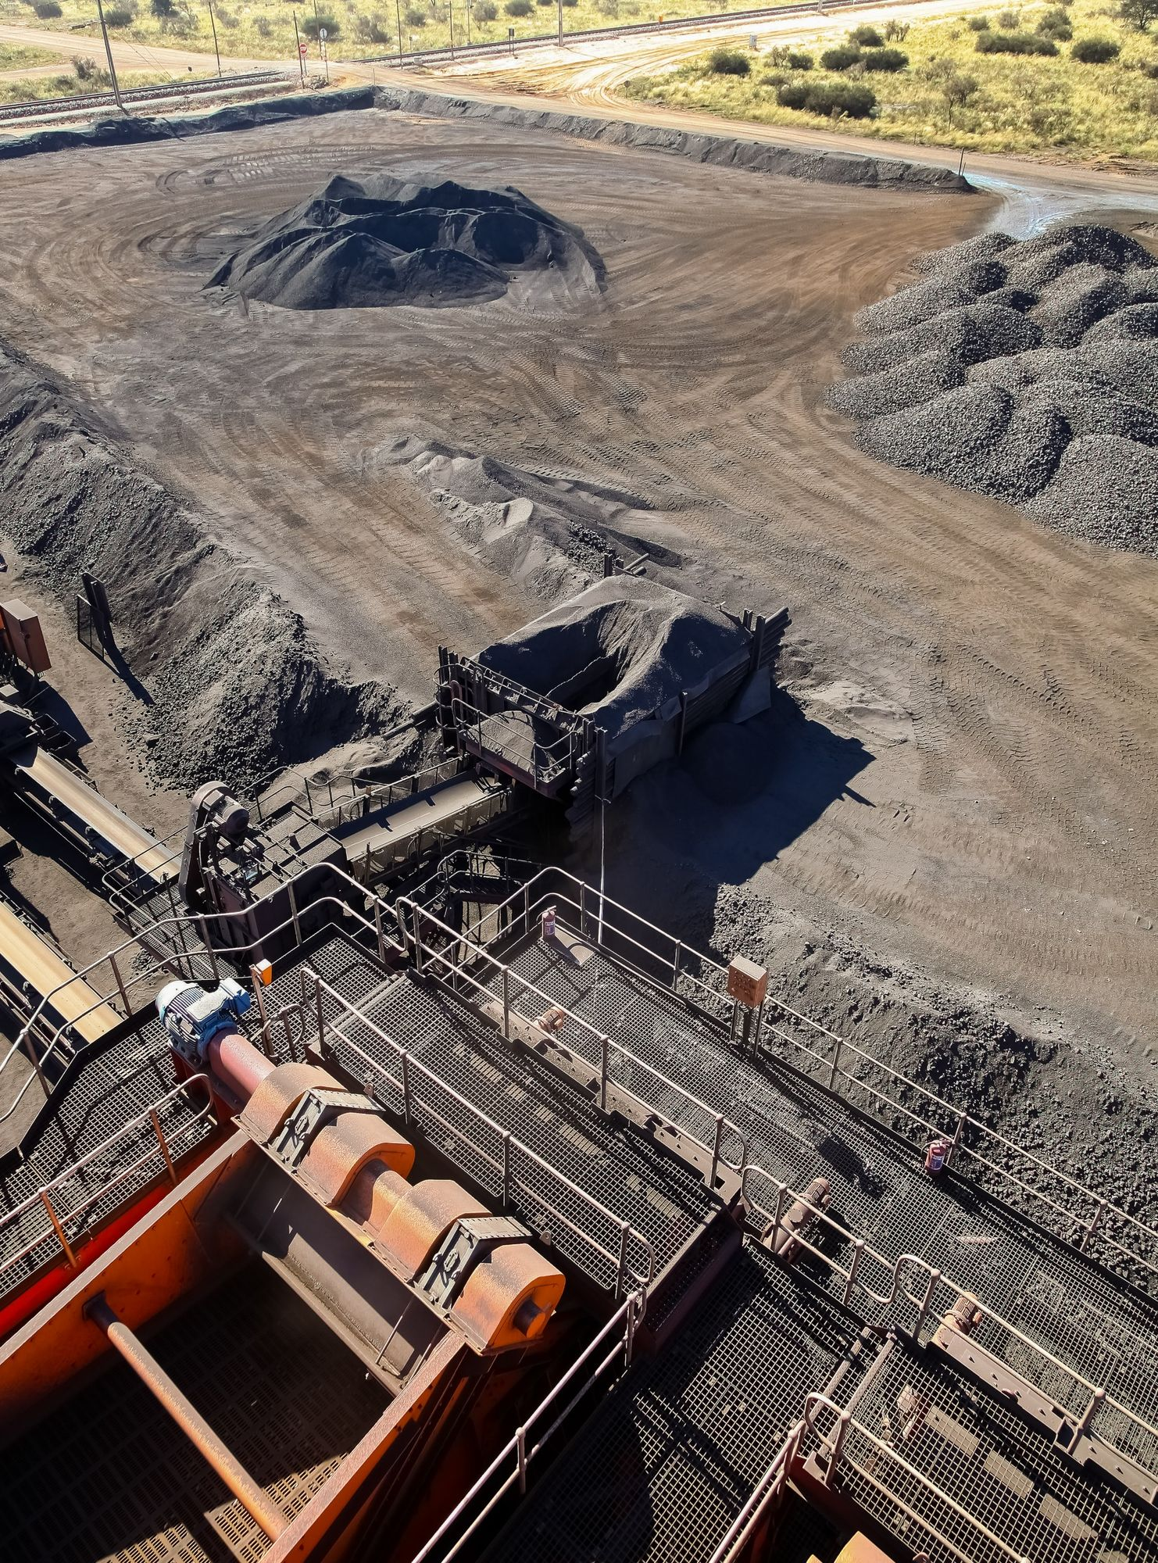
Results
Successfully inserted sample data across all tables
Generated daily production summaries
Forecast tables showing predicted tonnes

Slide 8
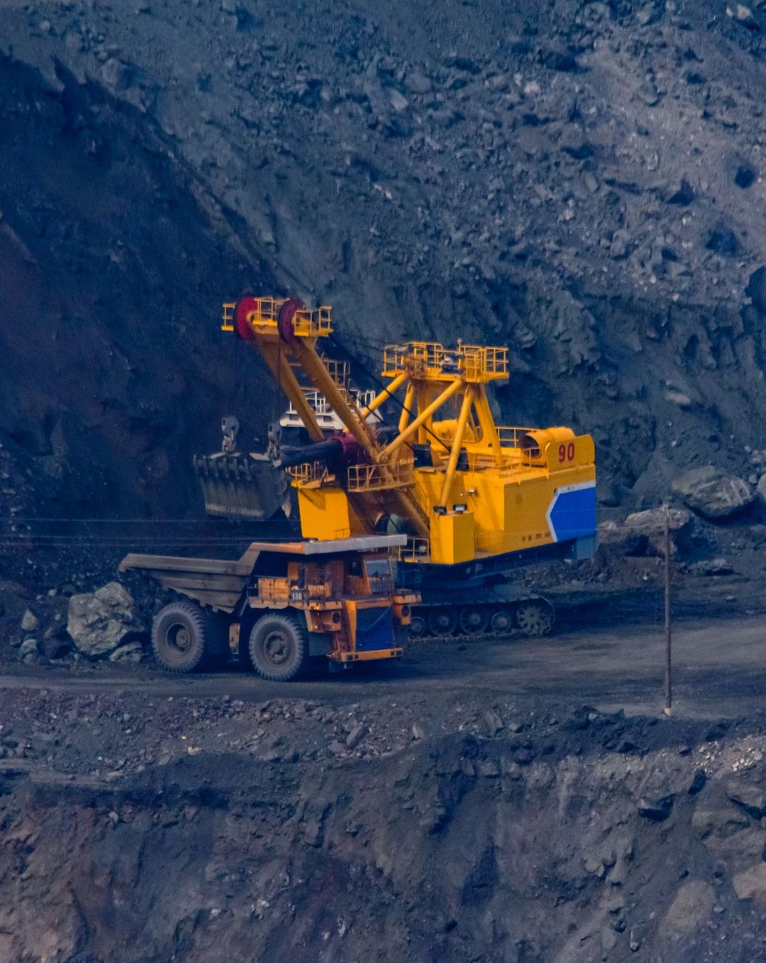
Conclusion (Achievements, Lessons)
Built full PL/SQL system for mining operations
Automated summaries & forecasting improve planning
Reduced human error and improved data quality
Learned: PL/SQL procedures, triggers, ER modeling, BPMN

Slide 9
Thank You!
We respect your valuable time with our presentation
If you have any questions, please ask

